Slide 1

SummAI: AI-Powered Business Summarization
Intelligent text summarization for business articles, reports, and emails using dual NLP approaches
Notes:
1

Slide 2
Group Members:
Akhil Babu Gujjarlapudi (AP23110011185)
Hyndhavi Chakka (AP23110010993)
Prasanna Kumar Katari (AP23110010760)
Vardhan Chebrolu (AP23110010042)
Krishna Chaitanya Maddala (AP23110010966)
Notes:
2

Slide 3

The Challenge: Information Overload
The Problem
Our Solution
Business professionals face overwhelming volumes of lengthy documents, articles, and email threads daily. Reading everything thoroughly is simply impossible.
SummAI delivers automated, intelligent summarisation that condenses lengthy content into actionable insights within seconds.
Traditional manual summarisation is time-consuming, inconsistent, and doesn't scale with modern information flow.
Dual-approach system combining extractive and abstractive methods ensures both accuracy and readability.
Notes:
3

Slide 4

Two Powerful Approaches
Extractive Summarisation
TextRank algorithm selects the most important sentences directly from the original text, preserving exact wording and eliminating hallucinations.
Fast processing
Factually accurate
No training required
Abstractive Summarisation
BART transformer model generates entirely new sentences that capture the essence, creating human-like summaries with better readability.
Natural language output
Combines information
More concise results
Notes:
4

Slide 5




System Architecture & Workflow
Input Processing
User submits business text through web interface. System tokenises and preprocesses content, handling documents up to 5,000 words.
Dual Model Processing
Content flows through both TextRank (graph-based ranking) and BART (400M parameter transformer) simultaneously for comparison.
Evaluation & Metrics
System calculates ROUGE scores and compares performance, providing quantitative analysis of summary quality.
Results Delivery
Both summaries displayed side-by-side with metrics, allowing users to compare approaches and select the best output.
Notes:
5

Slide 6

Dataset & Training Foundation
CNN/DailyMail Dataset
Why This Dataset?
High-quality human-written reference summaries
Industry-standard corpus with over 300,000 article-summary pairs from professional journalism.
Diverse topics: politics, business, technology, sport
Enables fair comparison with academic research
1,000
Well-structured and professionally curated
This benchmark dataset ensures our models meet rigorous academic and industry standards.
Training samples
100
Test samples
Notes:
6

Slide 7





Technology Stack
Core Framework
NLP & ML
Python 3.8+ with Flask web framework for rapid development and deployment of the application backend.
Hugging Face Transformers, NLTK, scikit-learn, and NetworkX for text processing and model implementation.
Deep Learning
Web Interface
PyTorch 2.0 backend powering the BART transformer with 400M+ parameters for abstractive generation.
Modern HTML/CSS with responsive design, real-time processing, and intuitive user experience.
Complete stack includes 12 major libraries across NLP, machine learning, web development, and data science domains.
Notes:
7

Slide 8
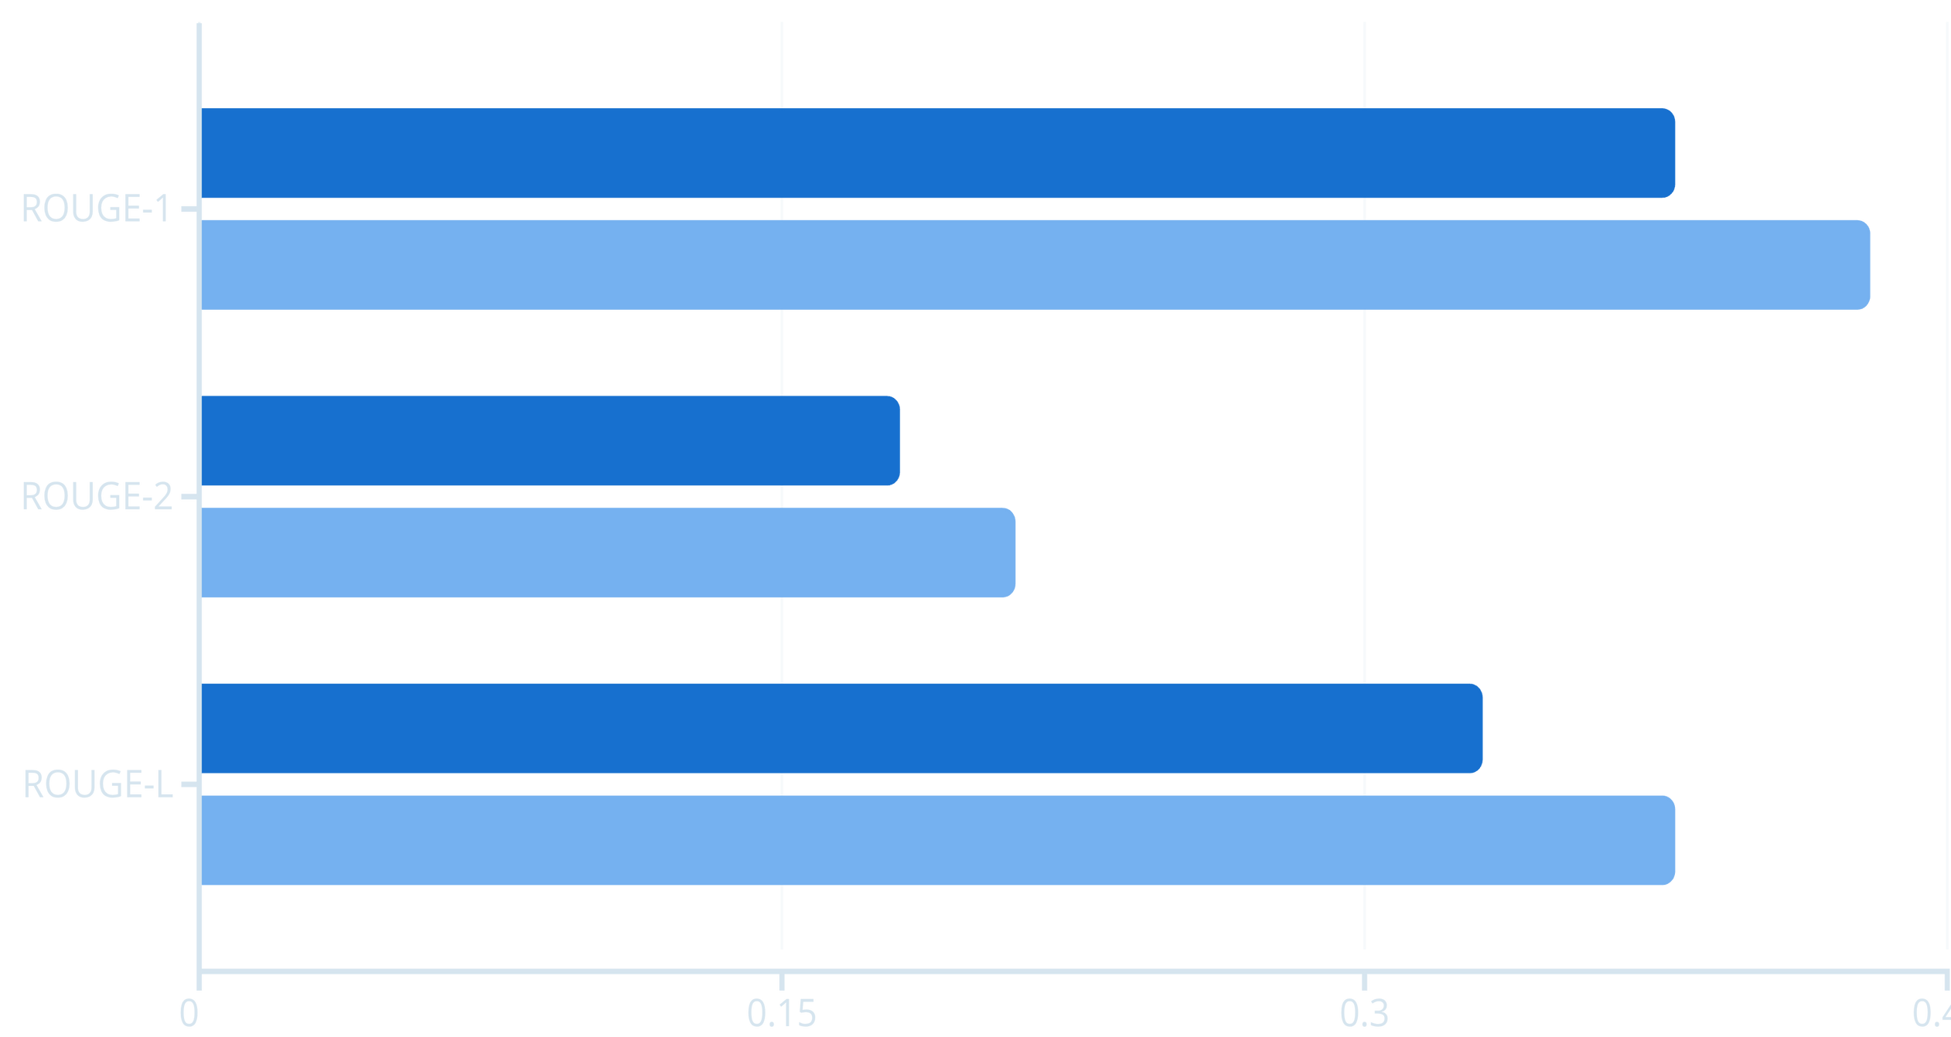
Performance Results
ROUGE Score Evaluation (100 Test Samples)
TextRank (Extractive)
BART (Abstractive)
Key Finding
Practical Impact
BART consistently outperforms TextRank across all metrics, producing more accurate and human-like summaries whilst maintaining factual integrity.
Both methods proved effective for business use, with extractive excelling at preserving exact terminology and abstractive providing superior readability.
Notes:
8

Slide 9
Real-World Applications
Executive Briefings
Email Management
Market Research
Customer Support
Condense lengthy reports into actionable insights for rapid decision-making in board meetings and strategic planning.
Summarise long email threads and correspondence for efficient inbox triage and improved response times.
Digest industry reports, competitive analysis documents, and news monitoring for strategic intelligence.
Generate ticket summaries, knowledge base articles, and FAQ content from support documentation.
Notes:
9

Slide 10

Future Development Roadmap
1
Multi-Language Support
Implement multilingual models for summarisation across languages with integrated translation capabilities.
2
Document Processing
Add PDF and Word document upload with batch processing for handling multiple files simultaneously.
3
Advanced Analytics
Integrate keyword extraction, entity recognition, sentiment analysis, and topic modelling for deeper insights.
4
Enterprise Features
Deploy user management, history tracking, API integration, and custom domain-specific models for business tools.
Notes:
10

Slide 11

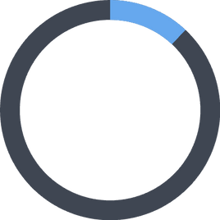
Project Impact & Achievements
800+
Key Accomplishments
Lines of code
Successfully implemented dual-approach NLP system combining traditional and modern techniques
Achieved production-ready deployment with intuitive web interface
Demonstrated measurable performance improvements with ROUGE evaluation
12
Created practical tool addressing real business intelligence needs
Technical Mastery
This project showcases end-to-end expertise across NLP, deep learning, web development, and software engineering—from dataset processing through model deployment.
Major libraries
1,100
Articles processed
Status: ✅ Completed & Ready for Deployment | Date: 04 December 2025
Notes:
11

